Slide 1
SWE 4803
Lec – 7

Slide 2
Executing Process Group
Consists of those processes performed to complete the work defined in the project management plan to satisfy the project requirements.

Slide 3
Executing Process Group
Activities:
Execute the work according to PM Plan
Produce product scope
Request changes
Implement only approved changes
Ensure common understanding and set expectations
Continuously improve
Keep Stakeholders engaged through Communication
This is the stage where deliverables are created and completed.

Slide 4
Executing Process Group
Processes:
Direct and Manage Project Work
Manage Project Knowledge
Manage Quality
Acquire Resource
Develop Team
Manage Team
Manage Communications
Implement Risk Responses
Conduct Procurements
Manage Stakeholder Engagement
9
10
1
2
3
4
5
6
7
8

Slide 5
Manage Quality
The process of translating the quality management plan into executable quality activities that incorporate the organization’s quality policies into the project.
Process
Output
Manage Quality
Quality Report
Test Document
Change requests
PM plan updates
Project documents update
OPA updates

Slide 6
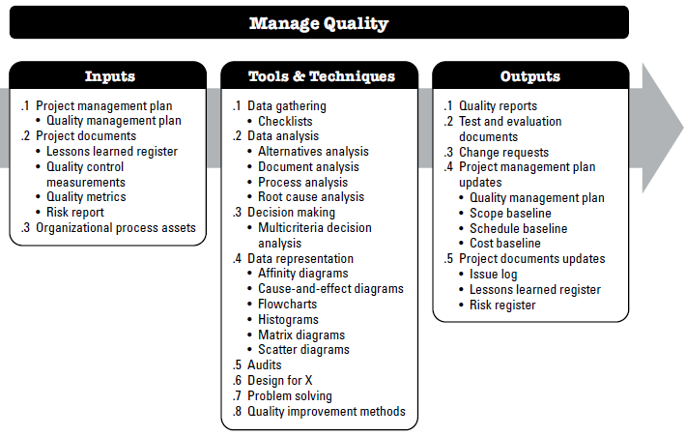
Manage Quality

Slide 7
Manage Quality
Input:
Project management plan - Quality management plan
Project documents
    Lessons learned register
    Quality control measurements
    Quality metrics
    Risk report
OPA (Organizational Process Assets)

Slide 8
Manage Quality
Tools & Techniques:
Data Gathering
Data analysis
    Alternatives analysis
    Document analysis
    Process analysis
    Root cause analysis
Decision Making - Multicriteria decision analysis
Data Representation
Audits
Design for X
Problem Solving
Quality improvement methods

Slide 9
Manage Quality
Tools & Techniques: Data Representation
  Affinity diagrams
  Cause-and-effect diagrams
  Flowcharts
  Histograms
  Matrix diagrams
  Scatter diagrams

Slide 10
Manage Quality
Tools & Techniques: Data Representation
Affinity diagrams
Allows large numbers of ideas to be classified into groups for review and analysis.
Means it is a method to organize targe amount of data into themes based on their relationship.
The following sequence of steps can be followed in order to create an Affinity Diagram
  Get your team to generate a pool of ideas via brainstorming for the problem.
  Display ideas such that they are clearly visible to everyone.
  Sort the ideas into logical groups.
  Create header cards or title cards for the groups.
  Draw the final affinity diagram.

Slide 11
Manage Quality
Tools & Techniques: Data Representation -- Affinity diagrams
  Problem: Why are we not making enough sales?
After brainstorming, your team generates ideas (written on post-it notes) as follows:
Next, we sort them in similar groups:
Set suitable header for each group

Slide 12
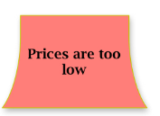
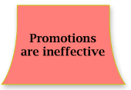
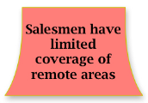

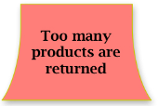
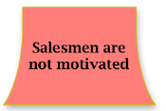
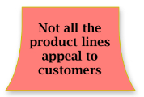
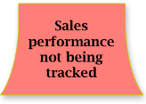
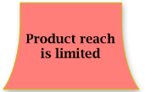
Manage Quality
Tools & Techniques: Data Representation -- Affinity diagrams
After brainstorming, your team generates ideas (written on post-it notes) as follows:

Slide 13
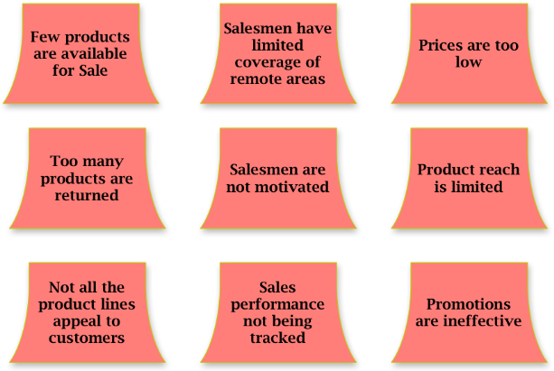
Manage Quality
Tools & Techniques: Data Representation -- Affinity diagrams
Next we sort them in similar groups:
Set suitable header for each group

Slide 14
Manage Quality
Tools & Techniques: Data Representation -- Cause-and-effect diagrams
Planning
Teamwork
Proper process not followed
are also known as fishbone diagrams, why-why diagrams, or Ishikawa diagrams.
This type of diagram breaks down the causes of the problem statement identified into discrete branches, helping to identify the main or root cause of the problem.
Inadequate mix of skills
Weak Strategy
Miss communication
Problem:
Inability to meet project Deadline
Poor task delegation
Inappropriate SW use
Poor-defined priority
Nobody has overall IT responsivity
Project Management
Information Technology

Slide 15
Manage Quality
Tools & Techniques: Data Representation -- Matrix diagrams
  used to analyze and understand the relationships between data sets.
  Matrix charts compare two or more groups of elements or elements within a single group.
  There are five basic types of matrix diagram:
    L-shaped matrix: creates a relationship between two items.
    T-shaped matrix: creates a relationship within three groups of items.
    Y-shaped matrix: creates a relationship within three groups of items but the relationship is displayed in a circular diagram for better understanding.
    C-shaped matrix: creates a relationship within three groups of items and displays it in 3D.
    X-shaped matrix: creates a relationship within four groups of items.

Slide 16
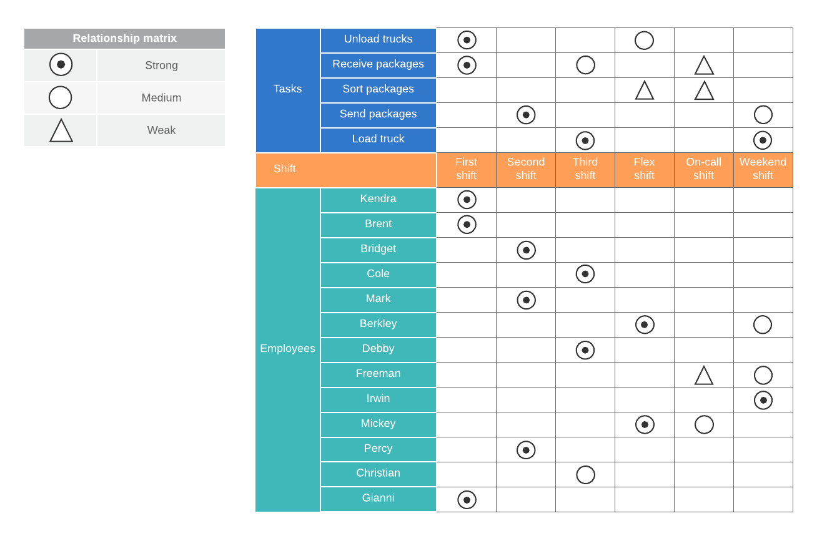

Slide 17
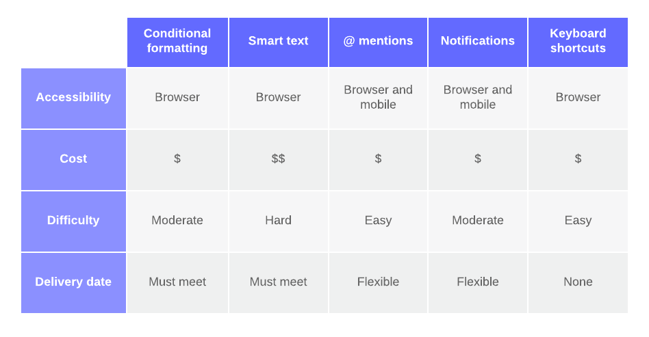

Slide 18
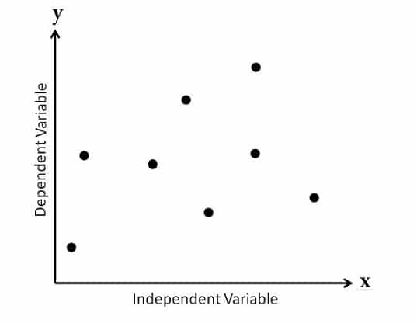
Manage Quality
Tools & Techniques: Data Representation -- Scatter diagrams
  is a graph that shows the relationship between two variables.
  The first variable is independent, and the second variable depends on the first.
  According to the correlation, you can divide scatter diagrams into the following categories:
    Scatter Diagram with No Correlation
    Scatter Diagram with Moderate Correlation
    Scatter Diagram with Strong Correlation
the data point spread is so random that you cannot draw a line through them – no correlation

Slide 19
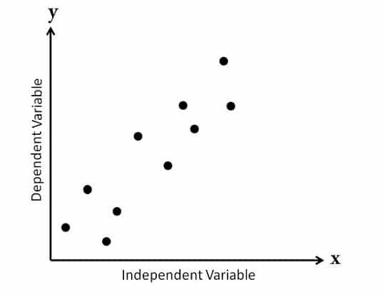
Manage Quality
Tools & Techniques: Data Representation -- Scatter diagrams
  is a graph that shows the relationship between two variables.
  The first variable is independent, and the second variable depends on the first.
  According to the correlation, you can divide scatter diagrams into the following categories:
    Scatter Diagram with No Correlation
    Scatter Diagram with Moderate Correlation
    Scatter Diagram with Strong Correlation
data points are a little closer and you can see that some kind of relationship exists between these variables – moderate correlation

Slide 20
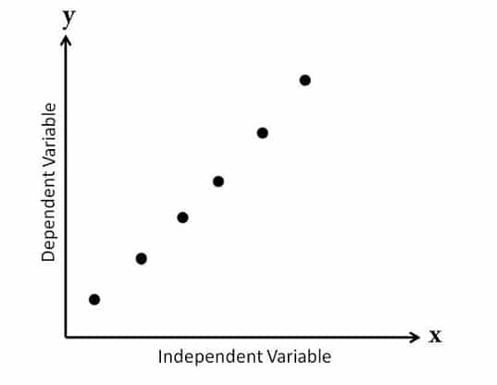
Manage Quality
Tools & Techniques: Data Representation -- Scatter diagrams
  is a graph that shows the relationship between two variables.
  The first variable is independent, and the second variable depends on the first.
  According to the correlation, you can divide scatter diagrams into the following categories:
    Scatter Diagram with No Correlation
    Scatter Diagram with Moderate Correlation
    Scatter Diagram with Strong Correlation
data points are a very closer and you can see that some kind of relationship exists between these variables – strong correlation

Slide 21
Manage Quality
Tools & Techniques:
Audits
  Quality audit is a structured, independent review to determine whether project activities comply with organizational and project policies, process and procedure.
Design for X
  is a set of technical guidelines that may be applied during the design of a product for the optimization of a specific aspect of the design. DfX can control or even improve the product’s final characteristics.
Example:
Design for Reliability (DfR)
Using high-quality capacitors in an electronic device to prevent failure under heat or voltage fluctuations.
Result: Increases customer satisfaction and reduces returns.
Design for Environment (DfE)
Creating a mobile phone with biodegradable materials or designing it for easy disassembly and recycling.
Result: Environmentally sustainable and compliant with regulations.

Slide 22
Manage Quality
Tools & Techniques:
Problem Solving
  Problem solving demands finding solutions for issues or challenges.
  Problem-solving methods generally include the following elements:
    Defining the problem,
    Identifying the root-cause,
    Generating possible solutions,
    Choosing the best solution,
    Implementing the solution, and
    Verifying solution effectiveness.
Quality improvement methods
  can occur based on findings and recommendations from quality control processes, the findings of the quality audits, or problem solving in the Manage Quality process.
  Plan-do-check-act and Six Sigma are two of the most common quality improvement tools used to analyze and evaluate opportunities for improvement.

Slide 23
Manage Quality
Output:
Quality reports
  The quality reports can be graphical, numerical, or qualitative.
  The information provided can be used by other processes and departments to take corrective actions in order to achieve the project quality expectations.
Test and evaluation documents
Change Request
PM plan updates - Quality management plan, Scope baseline, Schedule baseline, Cost baseline
Project documents updates - Issue log, Lessons learned register, Risk register

Slide 24
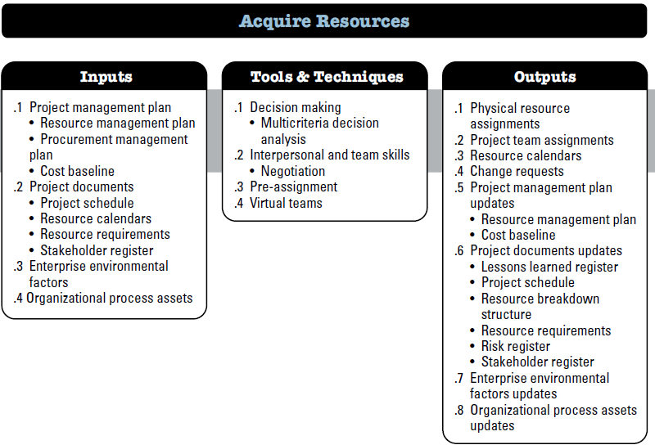
Acquire Resources
The process of obtaining team members, facilities, equipment, materials, supplies, and other resources necessary to complete project work.

Slide 25
Acquire Resources
Input:
Project management plan
    Resource management plan, Procurement management plan, Cost baseline
Project documents
    Project schedule , Resource calendars, Resource requirements, Stakeholder register
EEF & OPA
    Existing information on organizational resources including availability, competence levels, and prior experience for team resources and resource costs;
    Marketplace conditions;
    Organizational structure; and
    Geographic locations.
    Policies and procedures for acquiring, allocating, and assigning resources to the project
    Historical information and lessons learned repository.

Slide 26
Acquire Resources
Tools & Techniques:
Decision Making
Interpersonal and team skills
Audits
Pre-assignment - Project team members selected in advance
Virtual teams - Group of people with shared goal who fulfill their role without meeting face to face

Slide 27
Acquire Resources
Tools & Techniques:
Decision Making
  selection criteria that can be used:
    Availability. Verify that the resource is available to work on the project within the time period needed.
    Cost. Verify if the cost of adding the resource is within the prescribed budget.
    Ability. Verify that the resource provides the capability needed by the project.
  Some selection criteria that are unique for team resources are:
  Experience. Verify that the team member has the relevant experience that will contribute to the project success.
  Knowledge. Consider if the team member has relevant knowledge of the customer, similar implemented projects, and nuances of the project environment.
  Skills. Determine if the team member has the relevant skills to use a project tool.
  Attitude. Determine if the team member can work with others as a cohesive team.
  International factors. Consider team member location, time zone, and communication capabilities.

Slide 28
Acquire Resources
Output:
Physical resource assignments
Project team assignments
Resource calendars
Project documents updates - Lessons learned register, Risk register, RBS, Project Schedule, Resource requirement…
Project management plan updates - Resource management plan, Cost baseline.
Enterprise environmental factors updates
  Resource availability within the organization, and
  Amount of the organization’s consumable resources that have been used.
Organizational process assets Updates
  documentation related to acquiring, assigning and allocating resources.

Slide 29
Acquire Resources
Factors to be considered:
The project manager of project management team should effectively negotiate and influence others to acquire required team.
Failure to acquire HR for the project may affect project schedule, budgets customer satisfaction , quality, risk etc.
Alternative resources might not have required competencies

Slide 30
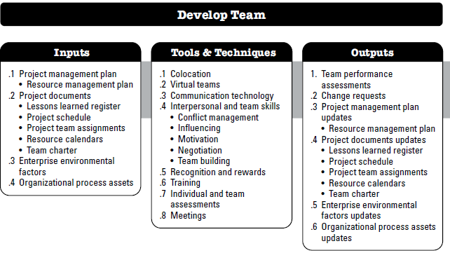
Develop Team
The process of improving competencies, team member interaction, and the overall team environment to enhance project performance.

Slide 31
Develop Team
Input:
Project management plan
    Resource management plan
Project documents
    Lessons learned register, Project schedule , Resource calendars, Resource requirements, Project team assignments, Team Charter
EEF & OPA
    Human resource management policies regarding hiring and termination, employee performance reviews, employee development and training records, and recognition and rewards;
    Team member skills, competencies, and specialized knowledge;
    Geographic distribution of team members.
    Historical information and lessons learned repository.

Slide 32
Develop Team
Tools & Techniques:
Colocation
  involves placing many or all the most active project team members in the same physical location to enhance their ability to perform as a team.
  Colocation can be temporary, such as at strategically important times during the project, or can continue for the entire project
Virtual teams - Group of people with shared goal who fulfill their role without meeting face to face
Communication Technology
  Shared portal
  Video/audio conferencing
  Email/chat

Slide 33
Develop Team
Tools & Techniques:
Interpersonal and team skills
  Conflict management
  Influencing
  Motivation
  Negotiation
  Team building
Recognition and reward
  Best way to keep your team motivated.
  Only desirable behavior should be rewarded
  ‘Win-lose’(zero sum) reward is not desirable. Reward criteria should be what all can achieve.
Win-lose’(zero sum) reward creates:
  Competition over collaboration
  Fear of sharing knowledge
  Low team morale
  Unhealthy work environment

Slide 34
Develop Team
Tools & Techniques:
Training
Individual and Team Assessment
  To assess team preferences, aspirations, how they process and organize information, how they tend to make decision and how they prefer to interact with people
  Attitudinal surveys, specific assessments, structured interviews, ability test, focus group. These tools can provide improved understanding, trust, commitment and communication
Meetings

Slide 35
Develop Team
Output:
Team performance assessments
  Improvement in skill that allow individuals to perform assignments more effectively
  Improvement in competencies
  Reduced staff turnover rate
  Increased team cohesiveness where team members share information and experience openly
Change requests
Project documents updates - Lessons learned register, Project schedule , Resource calendars, Project team assignments, Team Charter
Project management plan updates - Resource management plan
Enterprise environmental factors updates- Updates for employee training records and skills assessments
Organizational process assets Updates

Slide 36
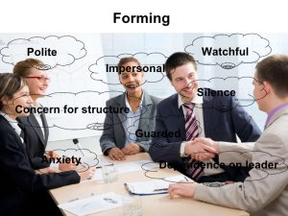
Develop Team
Stages of Team Development:
According to the Psychologist Bruce Tuckman, there are 5 stages in team development:
  Forming
  Storming
  Norming
  Performing
  Adjourning
people are bought together as a team

Slide 37
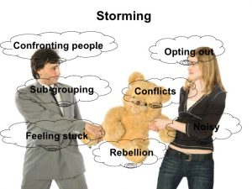
Develop Team
Stages of Team Development:
According to the Psychologist Bruce Tuckman, there are 5 stages in team development:
  Forming
  Storming
  Norming
  Performing
  Adjourning
members begins to address project work. If they are not open to different ideas, environment can become destructive

Slide 38
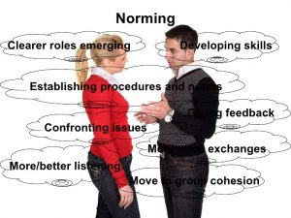
Develop Team
Stages of Team Development:
According to the Psychologist Bruce Tuckman, there are 5 stages in team development:
  Forming
  Storming
  Norming
  Performing
  Adjourning
team members starts to adjust and work together

Slide 39
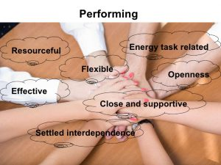
Develop Team
Stages of Team Development:
According to the Psychologist Bruce Tuckman, there are 5 stages in team development:
  Forming
  Storming
  Norming
  Performing
  Adjourning
team member functions as a well-organized unit

Slide 40

Develop Team
Stages of Team Development:
According to the Psychologist Bruce Tuckman, there are 5 stages in team development:
  Forming
  Storming
  Norming
  Performing
  Adjourning
team members completes the project work and moves on from the project

Slide 41
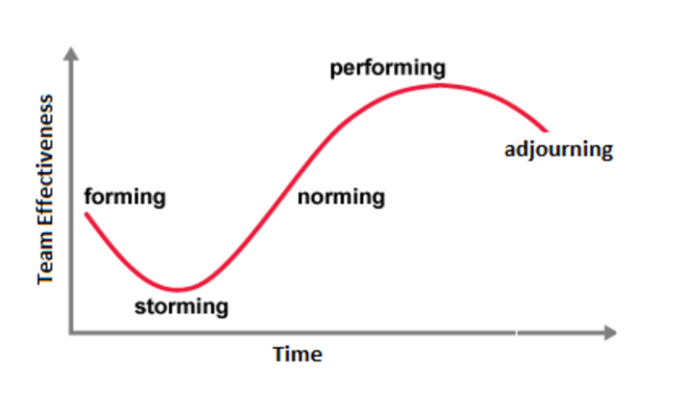
Develop Team
Stages of Team Development:
According to the Psychologist Bruce Tuckman, there are 5 stages in team development:
  Forming
  Storming
  Norming
  Performing
  Adjourning
Most high-performing teams go through five stages of team development.

Slide 42
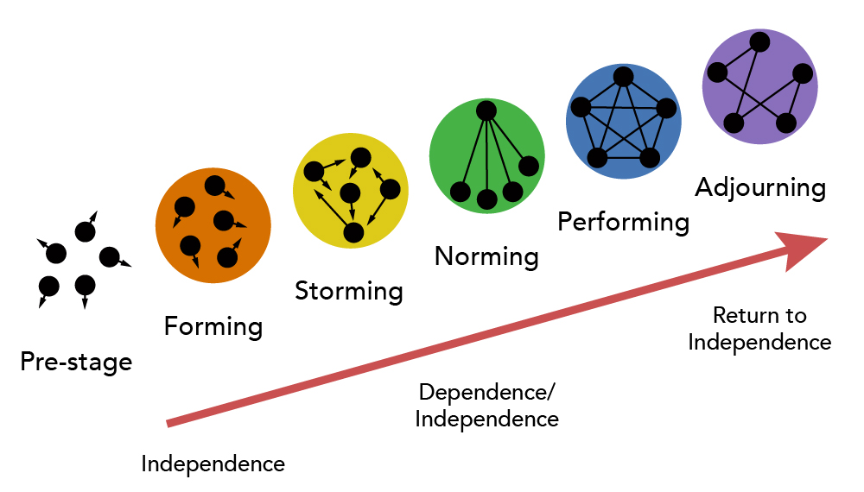
Develop Team
Stages of Team Development:
According to the Psychologist Bruce Tuckman, there are 5 stages in team development:
  Forming
  Storming
  Norming
  Performing
  Adjourning
Most high-performing teams go through five stages of team development.

Slide 43
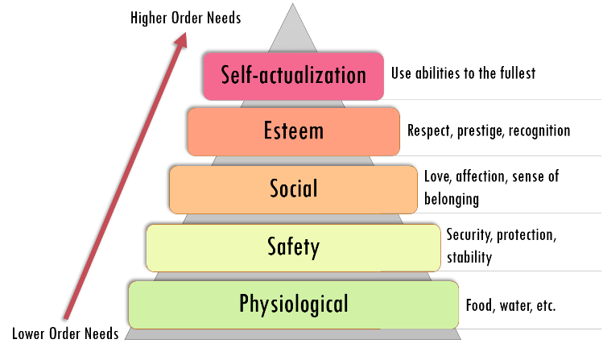
Develop Team
Maslow’s hierarchy of need:
People will not be interested at a particular level of needs unless their lower-level needs were fulfilled.

Slide 44
Develop Team
Herzberg’s Motivation-Hygiene Theory:
Frederick Herzberg proposed a motivational theory, known as Motivation-Hygiene theory or
Two-factor theory.
  people’s job satisfaction depends on two kinds of factors, hygiene factors and motivators.
Motivators (Job Satisfaction) | Hygiene Factors (Job Dissatisfaction)
Achievement | Company policies
Recognition | Supervision quality
Work itself | Salary and benefits
Responsibility | Job security
Advancement / Promotion | Working conditions
Personal growth / Development | Interpersonal relationships (with peers, bosses)
Improving hygiene factors prevents dissatisfaction but doesn’t create satisfaction.
True motivation comes from motivator factors, not just from fixing poor hygiene.
Managers should address both sets of factors to enhance employee performance and morale.

Slide 45

Develop Team
McGregor’s Theory X and Theory Y:
Douglas McGregor proposed two contrasting theories about management styles, authoritarian (Theory X) and participative (Theory Y)
Theory X (Authoritative Style) | Theory Y (Participative Style)
Assumes employees dislike work | Assumes employees enjoy work
Must be forced, controlled, or threatened | Are self-motivated and self-directed
Prefer to be directed and avoid responsibility | Accept and seek responsibility
Have little ambition | Are ambitious and creative
Focus is on job security | Focus is on achievement and development
Managers use strict supervision and control | Managers use trust, empowerment, and collaboration

Slide 46
Develop Team
Power of a project manager:
Formal (legitimate): This power is based on the position of the project manager
Reward: This power stems from giving rewards
Penalty (Coercive): This power comes from the ability to penalize team members
Expert: This power comes from being the technical expert or even the project management expert
Referent: Referent is the power of charisma and fame. This power comes from another person liking the project manager, respecting him, or wanting to be like him.

Slide 47
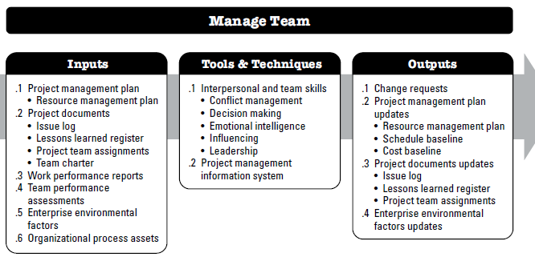
Manage Team
The process of tracking team member performance, providing feedback, resolving issues, and managing team changes to optimize project performance.

Slide 48
Manage Team
Input:
Project management plan
    Resource management plan
Project documents
    Issue log, Lessons learned register, Project team assignments, Team Charter
Work Performance Report – The information from performance reports and related forecasts assists in determining future team resource requirements, recognition and rewards, and updates to the resource management plan.
Team performance Assessments – by continually assessing the project team’s performance, actions can be taken to resolve issues, modify communication, address conflict, and improve team interaction.
EEF & OPA
    Human resource management policies
    Certificates of appreciation,
    Corporate apparel, and
    Other organizational perquisites.

Slide 49
Manage Team
Tools & Techniques:
Interpersonal and team skills
  Conflict management
  Decision making
  Emotional intelligence
  Influencing
  Leadership
PIMS - can be used for managing and coordinating team members across project activities.

Slide 50
Conflict
Projects involve multiple people with different opinions, expectations, values, and ways of working, coming together to manage and execute tasks.
Hence at some point, conflicts are bound to arise.
The reasons can be anything – opposing ideas, project stress, unforeseen requirements, budgetary constraints, lack of commitment, or personal ego clashes.
When a conflict arises, it negatively impacts all the people involved from the top-level management to lower level.
If not addressed on time, conflicts can hamper project progress and employee productivity, leading to delayed and poor-quality deliverables.

Slide 51
Conflict
Source of Conflict:
project priorities
View of project participants will differ over sequence of activities and tasks
administrative procedures
Managerial and Administrative oriented conflict over how the project will be managed
technical options and
Performance trade-offs
Disagreements over the technical issues, performance specifications and trade-offs
Disagreements on interpersonal issues
Conflicts concerning staffing of project team with personnel from other areas
Conflict over cost estimates from support areas regarding work breakdown structures
Disagreements about the timing, sequencing, and scheduling of project related tasks
Human resources
cost
schedules
Personality conflict

Slide 52
Conflict
How to resolve:
1. Withdraw/avoid
One party chooses not to deal with the conflict right now.
Behavior: Delays, ignores, or removes themselves from the situation.
Result: Temporary peace, but the issue remains unresolved and may resurface.
Best used when:
  The issue is trivial.
  Emotions are too high.
  More time is needed to prepare.
Example: Two colleagues are arguing about who should lead a project. One of them says, “Let’s talk about this later,” and leaves the room. The issue stays unresolved but the argument stops—for now.
2. Smooth / Accommodate
  You try to keep the peace by agreeing with the other person, even if you don’t fully agree.
  Behavior: You give up what you want to make the other person happy.
  Result: Creates harmony, but you might feel unhappy or ignored later.
  Best used when:
    Maintaining relationships is more important than winning.
    You realize you're wrong.
    It’s not a big issue and won’t happen again.
  Example: You want to watch an action movie, but your friend insists on a romantic comedy. You say, “Sure, let’s watch your choice tonight, ”even though it's not your favorite — just to keep the mood light.

Slide 53
Conflict
3. Compromise / Reconcile
  Each party gives up part of their demands to reach a middle ground.
  Behavior: Negotiation and trade-offs.
  Result: Partial satisfaction for both sides (win-some, lose-some).
  Best used when:
    Both parties have equal power.
    A quick, fair solution is needed.
    Time constraints exist.
    Two team members want different tools for a project.
  Example: One wants Tool A, the other prefers Tool B. They agree to use Tool A now, but switch to Tool B in the next phase. Each gave up part of their preference, but both are somewhat satisfied.
4. Force / Direct
  One party imposes their will over the other.
  Behavior: Aggressive, assertive, or authoritative approach.
  Result: One party wins (temporarily), but the other feels defeated or resentful.
  Best used when:
    Quick decision is vital (e.g., emergencies).
    Unpopular decisions are necessary.
    Discipline must be enforced.
  Example: A manager says, “We’re using this design, no further discussion, ”even if the team disagrees — because a quick decision is needed.

Slide 54
Conflict
How to resolve:
5. Collaborate / Problem Solve
  Both parties work together to find a win-win solution.
  Behavior: Open dialogue, mutual respect, and brainstorming.
  Result: Long-term resolution that satisfies everyone involved.
  Best used when:
    Issues are complex and important.
    Both parties' views are valid.
    Relationship and outcome matter equally.
  Example: Two developers disagree on a feature implementation. Instead of arguing, they meet, list the pros and cons of both ideas, and build a new version that combines the best parts of each. Everyone feels heard and the final solution is better.

Slide 55
Conflict
Which process involve most of the conflicts:
Process Group | process
Initiating | Develop Project Charter
Planning | Develop Project Management Plan
Execution | Develop Team
 | Manage Team
 | Manage Stakeholder Engagement
 | Manage Communications

Slide 56
Manage Team
Output:
Change requests
Project management plan Updates
  Resource management plan
  Schedule baseline
  Cost baseline
Project documents updates
  Issue log
  Lessons learned register
  Project team assignments
Enterprise environmental factors updates
  Input to organizational performance appraisals, and
  Personnel skill..

Slide 57
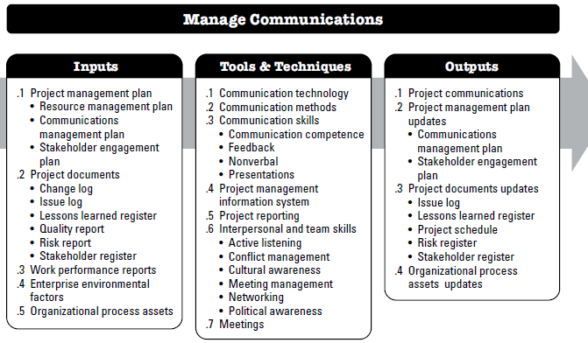
Manage Communication
The process of ensuring timely and appropriate collection, creation, distribution, storage, retrieval, management, monitoring, and the ultimate disposition of project information.

Slide 58
Manage Communication
Input:
Project management plan
    Resource management plan, Communications management plan, Stakeholder engagement plan
Project documents
    Change log, Issue log, Lessons learned register, Quality report, risk report, Stakeholder register
Work Performance Report
EEF
    Organizational culture, political climate, and governance framework;
    Personnel administration policies;
    Stakeholder risk thresholds;
    Established communication channels, tools, and systems;
    Global, regional, or local trends and practices or habits; and
    Geographic distribution of facilities and resources.

Slide 59
Manage Communication
Input:
OPA
    Corporate policies and procedures for social media, ethics, and security;
    Corporate policies and procedures for issue, risk, change, and data management;
    Organizational communication requirements;
    Standardized guidelines for development, exchange, storage, and retrieval of information;
    Historical information from previous projects, including the lessons learned repository.

Slide 60
Manage Communication
Tools & Techniques:
Communication technology
  whether the team is co-located, the confidentiality, resources available to the team members, and how the organization’s culture influences the way in which meetings and discussions are normally conducted.
Communication methods
  The choice of communication methods should allow flexibility in the event that the membership of the stakeholder community changes, or their needs and expectations change.
Communication skills
PIMS
Project Reporting
Interpersonal and team skills
  Active listening
  Conflict management
  Cultural awareness
  Meeting management
  Networking
  Political awareness
Meetings

Slide 61
Manage Communication
Output:
Project Communications
Project management plan Updates
  Communications management plan
  Stakeholder engagement plan
Project documents updates
  Issue log
  Lessons learned register
  Project schedule
  Risk register
  Stakeholder register
OPA updates.
  Project records such as correspondence, memos, meeting minutes and other documents used on the project; and
  Planned and ad hoc project reports and presentations.

Slide 62
Manage Communication
OPA updates

Slide 63
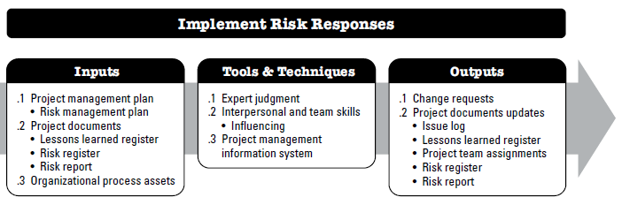
Implement Risk Responses
the process of implementing agreed-upon risk response plans.
The key benefit of this process is that it ensures that agreed-upon risk responses are executed as planned in order to address overall project risk exposure, minimize individual project threats, and maximize individual project opportunities…

Slide 64
Implement Risk Responses
Input:
Project management plan
    Risk management plan
Project documents
    Lessons learned register, risk report, Risk register
OPA
    lessons learned repository from similar completed projects

Slide 65
Implement Risk Responses
Tools & Techniques:
Expert Judgement
Interpersonal and team skills
PIMS

Slide 66
Implement Risk Responses
Output:
Change Requests
  Implementation of risk responses may result in a change request to the cost and schedule baselines or other components of the project management plan.
Project documents updates
  Issue log
  Lessons learned register
  Project Team Assignment
  Risk register
  Risk report

Slide 67
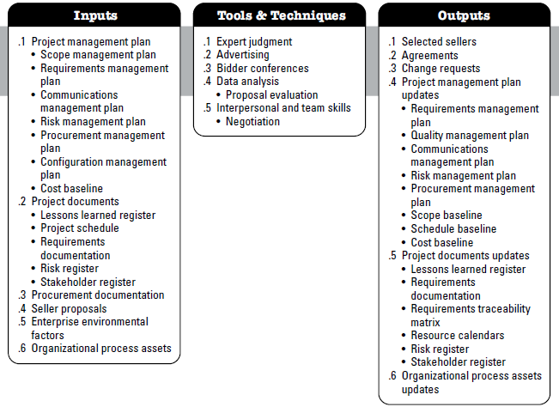
Conduct procurement
the process of obtaining seller responses, selecting a seller, and awarding a contract.
The key benefit of this process is that it selects a qualified seller and implements the legal agreement for delivery.

Slide 68
Conduct procurement
Input:
Project management plan
    Scope management plan, Requirements management plan, Communications management plan, Risk management plan, Procurement management Plan, Configuration management plan, Cost baseline
Project documents
    Lessons learned register, Project schedule, Requirements documentation, Risk register, Stakeholder register
Procurement documentation
  Bid document, Procurement SOW, Independent cost estimates
Seller Proposals
  Seller proposals, prepared in response to a procurement document package, form the basic information that will be used by an evaluation body to select one or more successful bidders (sellers).

Slide 69
Conduct procurement
Input:
EEF
  Local laws and regulations regarding procurements;, Local laws and regulations ensuring that the major procurements involve local sellers etc.
OPA
  List of preferred sellers that have been prequalified, Organizational policies that influence the selection of a seller etc.

Slide 70
Conduct procurement
Tools & Techniques:
Expert Judgement
Advertising
  Advertisement in newspaper or other media. Sometimes govt has to advertise for specific items.
Bidding conference
  Sometimes contractor conference, vendor conference and pre-bid conference
  To ensure that all prospective sellers have common and clear understanding of the procurement
Data Analysis
Interpersonal and team skills
  Negotiation conclude with a contract document that can be executed

Slide 71
Conduct procurement
Output:
Selected sellers
  Selected sellers are those sellers who have been judged upon in evaluation, negotiated a draft contract.
  high value and critical award might need senior management approval
Agreements
  Can be simple form of purchase order of complex document.
  Regardless of document complexity, the contract document is legally binding.
  This is legal relationship subject to remedy in courts
  Component (SOW, schedule baseline, performance reporting, period of performance, roles and responsibilities, seller’s place of performance, pricing etc…)
Change requests

Slide 72
Conduct procurement
Output:
Project management plan Updates
  Requirements management Plan, Quality management plan, Communications management plan, Risk management plan, Procurement management Plan, Scope baseline, Schedule baseline, Cost baseline
Project Document updates
  Lessons learned register, Requirements documentation, Requirements traceability, Matrix, Resource calendars, Risk register, Stakeholder register
OPA Updates
  Listings of prospective and prequalified sellers; and
  Information on relevant experience with sellers, both good and bad.

Slide 73
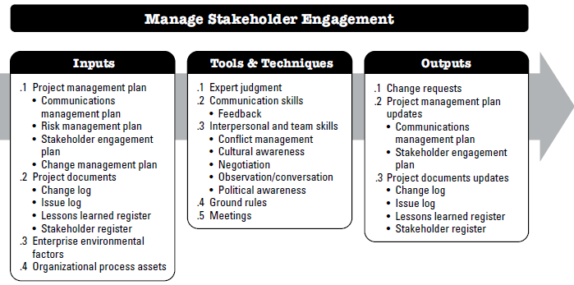
Manage stakeholder engagement
process of communicating and working with stakeholders to meet their needs and expectations, address issues, and foster appropriate stakeholder involvement.
The key benefit of this process is that it allows the project manager to increase support and minimize resistance from stakeholders..

Slide 74
Manage stakeholder engagement
Input:
Project management plan
    Change management plan, Communications management plan, Stakeholder engagement plan, Communication management plan
Project documents
    Change log, Issue log, Lessons learned register, Stakeholder register
EEF
    Organizational culture, political climate, and governance structure of the organization;, Personnel administration policies; Stakeholder risk thresholds; , Established communication channels;, Global, regional, or local trends, practices, or habits; and Geographic distribution of facilities and resources.
4. OPA
    Corporate policies and procedures for social media, ethics, and security; Corporate policies and procedures for issue, risk, change, and data management; Organizational communication requirements, Standardized guidelines for development, exchange, storage, and retrieval of information; and Historical information from previous similar projects.

Slide 75
Manage stakeholder engagement
Tools & Techniques:
Expert Judgement
Communication Skills
Interpersonal and team skills
  Negotiation
  Conflict management
  Cultural awareness
  Meeting management
  Observation
  Political awareness
Ground rules
  Ground rules, defined in the team charter set the expected behavior for project team members, as well as other stakeholders, with regard to stakeholder engagement.
Meetings

Slide 76
Manage stakeholder engagement
Output:
Change Requests
Project management plan Updates
  Communications management plan
  Stakeholder engagement plan
Project documents updates
  Issue log
  Lessons learned register
  Change log
  Stakeholder register

Slide 77
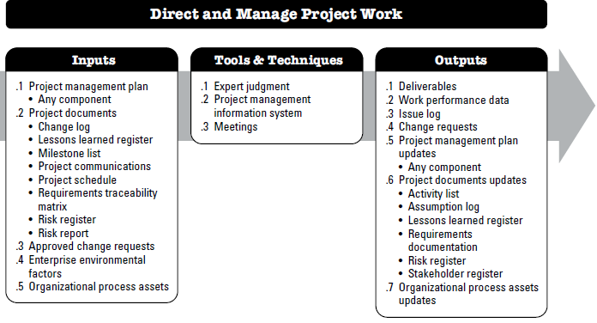
Direct and manage Project Work
is the process of leading and performing the work defined in the project management plan and implementing approved changes to achieve the project’s objectives.
The key benefit of this process is that it provides overall management of the project work and deliverables, thus improving the probability of project success.

Slide 78
Direct and manage Project Work
Input:
Project management plan
    Any component
Project documents
    Change log, Lessons learned register, Milestone list, Project communications, Project schedule, Requirements traceability matrix, Risk register, Risk report
Approved change requests
EEF & OPA

Slide 79
Direct and manage Project Work
Tools & Techniques:
Expert Judgement
PIMS
Meetings

Slide 80
Direct and manage Project Work
Output:
Deliverables
  A deliverable is any unique and verifiable product, result, or capability to perform a service that is required to be produced to complete a process, phase, or project. Deliverables are typically the outcomes of the project and can include components of the project management plan.
Work performance data
  Work performance data are the raw observations and measurements identified during activities being performed to carry out the project work
Issue log
Change requests
PM plan Updates
Project documents updates
  Activity list, Assumption log, Lessons learned register, Requirements documentation, Risk register,Stakeholder register
Organizational process assets Updates

Slide 81
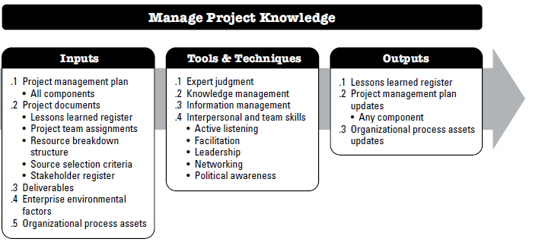
Manage Project Knowledge
is the process of using existing knowledge and creating new knowledge to achieve the project’s objectives and contribute to organizational learning.

Slide 82
Manage Project Knowledge
Input:
Project management plan
    All components
Project documents
    Lessons learned register, Project team assignments, Resource breakdown structure, Source selection criteria, Stakeholder register
Deliverables
EEF and OPA

Slide 83
Manage Project Knowledge
Tools & Techniques:
Expert Judgement
Knowledge management
  connect people so they can work together to create new knowledge, share tacit knowledge, and integrate the knowledge of diverse team members..
Information management
  effective for sharing simple, unambiguous, codified explicit knowledge. For example, include a “contact me” function so users can get in touch with the originators of the lessons and ask for advice specific to their project and context.
Interpersonal and team skills
  Active listening
  Facilitation
  Leadership
  Networking
  Political awareness

Slide 84
Manage Project Knowledge
Output:
Lessons learned register
Project management plan Updates
  Any components
Organizational process assets Updates

